Slide 1


Understanding Your Workplace Pension
October 2024
Farleigh House, Farleigh Court, Old Weston Road, Flax Bourton, Bristol BS48 1UR | 01275 462 469 | www.bowmorewealth.com

Slide 2

Your Workplace Pension
The Zuken pension scheme operated via the National Pensions Trust (NPT) is an Occupational Master Trust money purchase (Defined Contribution) pension scheme that meets Auto Enrolment requirements.
It meets various regulatory standards in terms of:
Each member has their own personal pension pot (Personal Account) which cannot be accessed by any other party. Not even your employer
Costs & Charges
Accessibility
Flexibility

Slide 3
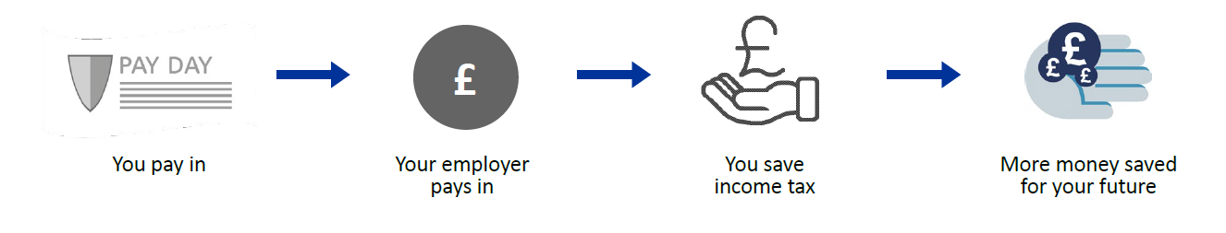
Your Workplace Pension
Your Workplace Pension is a tax efficient savings arrangement, funded by you, your employer and HMRC
You are required to contribute a minimum 4% salary to the plan, while Zuken pay 8%,
making a total contribution of 12% salary

Slide 4
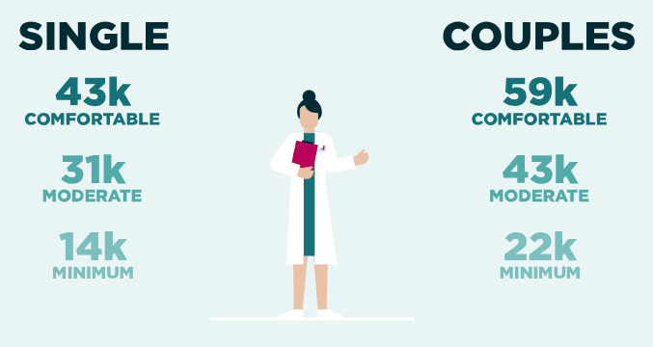
What Does Good Look Like?
The Pension & Lifetime Savings Association (PSLA) publishes an annual standard for current retirement living standards based on today’s costs and services. The above numbers assume full basic state pension applies.

Slide 5
Is the State Pension Enough?
The current full new state pension (2024/25) is £221.20 per week, equivalent to £11,502.40 per annum.
To qualify for the full state pension, you need to complete 35 full years National Insurance contributions (includes periods of employment, self-employment, certain periods on Job Seekers Allowance or other benefits, and Home
Responsibilities Protection.
Get a state pension forecast – BR19 - to check your entitlement.
If short – fill the gaps!

Slide 6
Building Your Retirement Plan
What Does it Cost Me?
Example 1 – Basic Rate Taxpayer
If you earn £25,000 and contribute 4% of salary:
Your payment is £83.33 per month
Zuken’s payment is £166.67 per month
£250.00 per month goes into your Pension Account each month, but only costs you £66.67 of your take-home pay
Example 2 – Higher Rate Taxpayer
If you earn £55,000 and contribute 4% of salary:
Your payment is £183.33 per month
Zuken’s payment is £366.67 per month
£550.00 per month goes into your Pension Account each month, but only costs you £110.00 of your take home pay
This can be boosted further by paying extra personal contributions and/or opting for Salary Exchange where you opt to reduce your salary in exchange for a higher Employer Pension Contribution and benefit from additional National Insurance savings

Slide 7
Rules of Thumb
Age | Target Pension Fund Value
30 | 1 x Salary
40 | 3 x Salary
50 | 6 x Salary
60 | 8 x Salary
67 | 10 x Salary
The above numbers are based on research provided by Fidelity, linked to the “4% rule”, assuming you aim to draw a sustainable income of 4% per annum gross for the remainder of your lifetime.
As a rule of thumb, this is not offered as advice but helps to provide a realistic milestone to which one can adjust plans over future years.

Slide 8
Building Your Retirement Plan
Your pension pot is funded by contributions paid in:
    By the company – 8% salary
    By you – 4% salary (may be boosted further via Salary Exchange)
    By any additional contributions you choose to make
    By other pension funds you may choose to transfer in

Slide 9
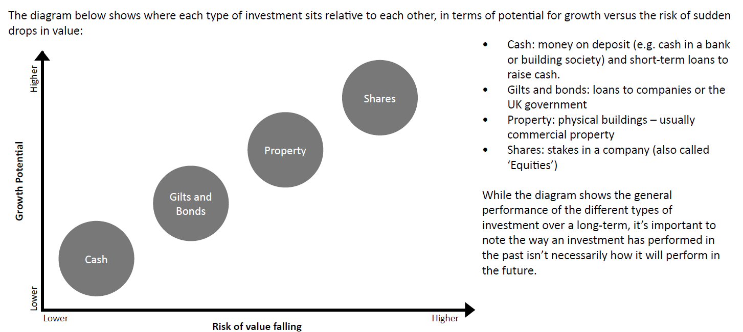
4 Major Asset Classes
https://www.zukenpensiontrust.co.uk/investment-choices/risk-and-reward/

Slide 10
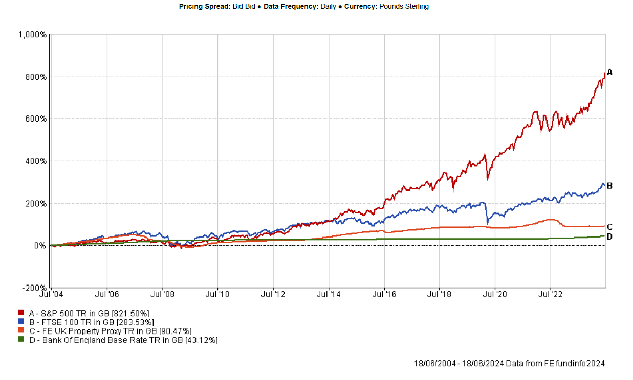
Investment Risk & Reward
Letting money work harder of the longer term by investing, not just saving

Slide 11
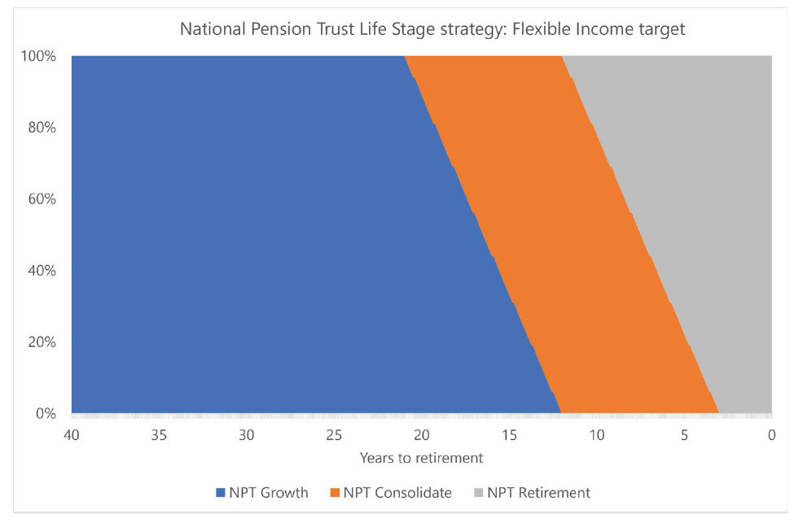
Default – Life Stage Strategy – Flexible Income Target
Starting at 100% global equity investment, up to 21 years before your Target Retirement Age to maximise growth potential.
The trustees then gradually move and redirect funds and contributions to lower risk assets over the remaining period.
When you are 3 years from retirement, you will be invested 40% in equities and 60% om a range of credit investments.

Slide 12
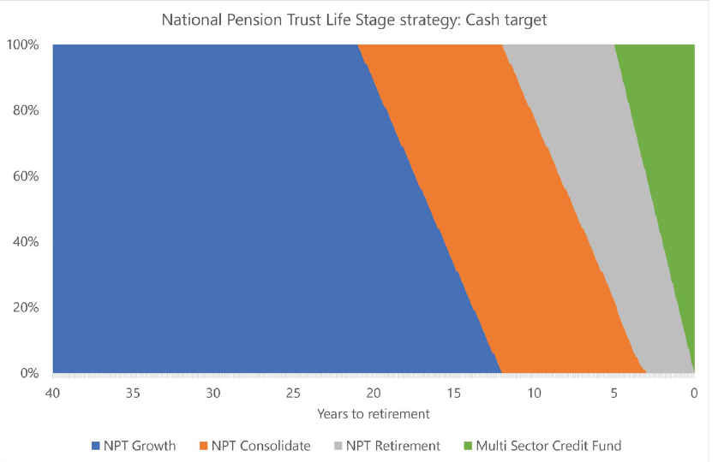
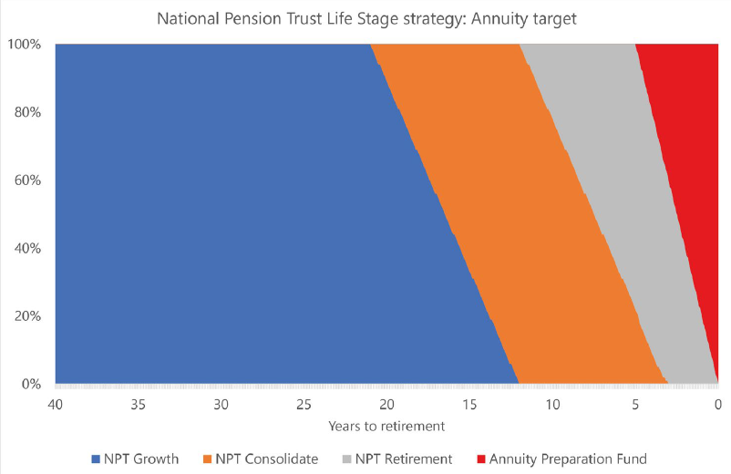
Default – Life Stage Strategy – Cash Target & Annuity Target

Slide 13
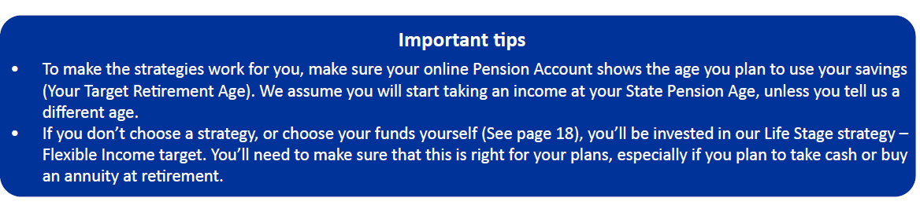

Default – Life Stage Strategy – Cash Target & Annuity Target
PLEASE NOTE – investing your retirement savings carries some kind of risk. The value could go down as well as up and you may get back less than you pay in. Inflation could also erode the value of your savings, if the price of things you need or want to buy in the future increase more than the value of your savings. By spreading your money into different funds and types of investment, you can help reduce the impact of these risks.
For more information, please refer to the Zuken YOUR INVESTMENT GUIDE – An introduction to helping your money grow

Slide 14
Workplace Pension – How it works
Contributions In
25% Tax Free
Investment
Growth
Your Personal Pension Pot
75% taxable

Slide 15
What If………..?
I LEAVE ZUKEN – contributions to your Personal Account will cease. You can leave the funds within the scheme to claim at a future date or can transfer them to a new personal or workplace pension plan. It is not possible to “cash in” a pension before retirement.
I DIE BEFORE REACHING RETIREMENT – the funds in your Personal Account are payable to your nominated beneficiaries. Under current legislation, such payments are usually tax free.
I WANT TO RETIRE EARLY – you can access your retirement funds at any time from age 55 onwards (increases to minimum age 57 from 6 April 2028), by requesting early retirement from the trustee.
I WANT TO RETIRE LATE – you can usually defer access to your pension funds beyond normal retirement age.
As any change to your chosen retirement age might affect your investment strategy, you should review such decisions to consider how these might impact your pension investments
NOTE – You do not have to take all pension plans simultaneously and you can draw pensions while still working (though remember that pension income is potentially taxable income, just like earnings)

Slide 16
Things To Be Aware Of
Currently, no Lifetime Allowance or LTA excess tax charge
Maximum tax-free cash at retirement is 25% of your fund with an overall aggregate limit of £268,275
Annual Allowance – AA - is now capped at £60,000 per annum
Tapered Annual Allowance – TAA – affects those with income of £260,000 up to £360,000, reducing the allowance by £2 for every £1 over the limit at which point the TAA is capped at £10,000 per annum
Money Purchase Annual Allowance – MPAA is capped at £10,000 per annum

Slide 17
Death Benefits
If you die before age 75, 100% of your pension pot will be paid to your chosen beneficiaries free of tax, subject to an overall aggregate limit of £1,073,100 from all pension plans LESS any tax-free cash already taken.
Complete a Nomination form – on paper/online/in app - Why?
To ensure that in the event of your untimely death, your pension fund can be passed on to your chosen beneficiaries without delay, tax-free and outside of your estate.
(Don’t forget that a separate Expression of Wish form is required for the Group Life Assurance scheme benefit!)

Slide 18
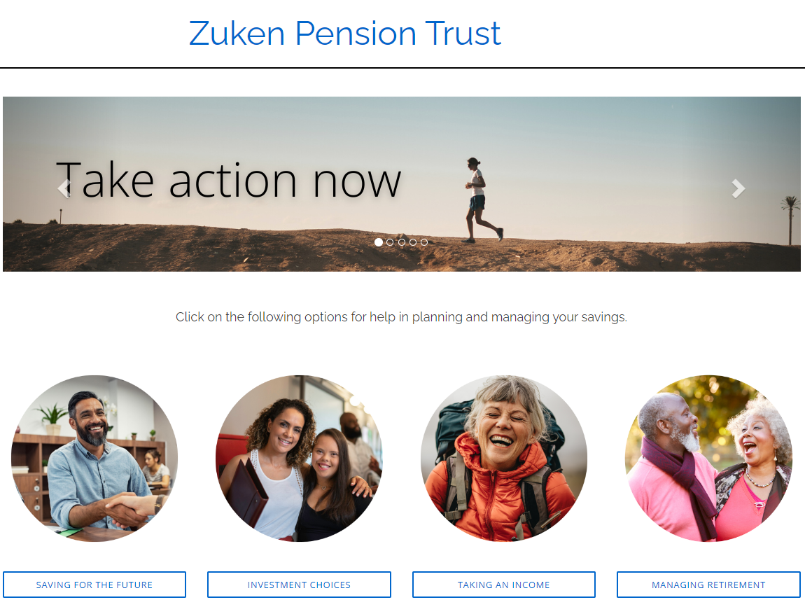
Workplace Pension & Support Services – Keep on Track
The website provides further information about your plan, including:
Several “how to” videos
A retirement forecaster
Information on how to transfer to other pensions
Further information on the scheme default investment approaches
Information on other investment options in the plan
An app for even easier access to your pension information is in development
Visit: https://www.zukenpensiontrust.co.uk

Slide 19

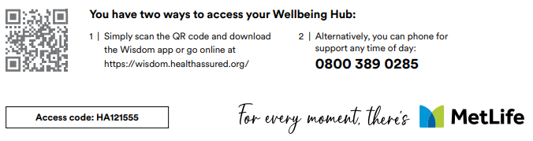
Group Life Assurance/Income Protection – Added Benefits
As well as providing a tax-free lump sum in the event of death, or regular income if you are unable to work due to injury or illness, your Group Life Assurance & Income Protection policies come with additional benefits which you may not be aware of. These are:
Wisdom App: Offering services covering financial wellbeing, mental wellbeing and physical wellbeing – scan QR code below
Everest Funeral Concierge: including a cloud-based, digital value, will writing, online funeral planning tools, 24/7 support for your loved ones
HealthHero App: digital healthcare service providing access to health experts 24/7, 365 days a year. Includes same-day GP access, unlimited consultations, open referrals, local prescription delivery and second medical opinions
An employee assistance programme (EAP) to support the emotional, physical and mental wellbeing of employees, 365, 24/7. Confidential phone line
Free Bereavement and Probate support (for bereaved families)
Up to 6 face-to-face bereavement counselling sessions
24-hour helpline available 365 days a year providing practical guidance and emotional support - for example on issues such as how to register a death, and help on how to obtain a grant of probate and letters of administration

Slide 20
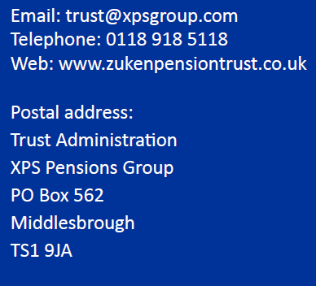
Useful Links & Contacts
https://www.zukenpensiontrust.co.uk
https://www.zukenpensiontrust.co.uk/DCModeller
https://www.gov.uk/government/publications/application-for-a-state-pension-statement
https://www.gov.uk/state-pension-age
https://www.gov.uk/find-pension-contact-details

Slide 21








Questions & Answers

Slide 22
Bowmore Financial Planning is authorised and regulated by the
Financial Conduct Authority no 115180
Past performance is not an indicator of future performance. The value of investments can fall as well as rise and any income is not guaranteed.
The material contained in this presentation is for information only and does not constitute investment advice or a recommendation to any reader of this material to buy or sell investments. It is based on information provided by the National Pensions Trust.
Bowmore Financial Planning Limited work with Zuken to provide group risk benefit arrangements and support employee communications. It does not work directly with the National Pensions Trust nor does it provide advice to Zuken on employer pension arrangements.

Slide 23
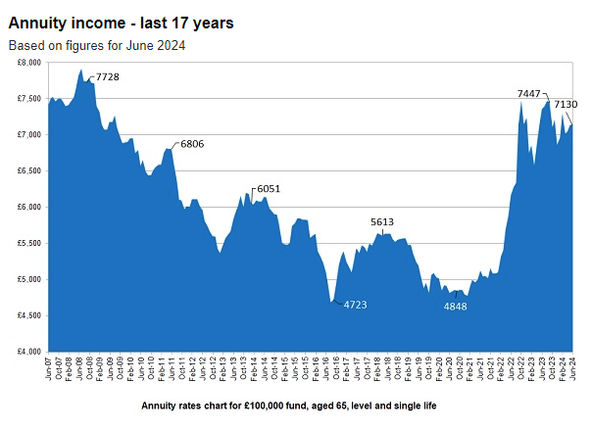
My Financial Overview
Source: sharingpensions.co.uk

